Slide 1

Stock Market Prediction using Deep Learning
This presentation outlines a deep learning approach to predicting stock market prices, focusing on a one-month forecast using time-series analysis.
Team Members:
Aadi Bhardwaj
Arkadeep Roy
Deepjyoti Das
Souvik Das
Souvik Mukherjee
Vaibhav Shaw

Slide 2
Project Overview: Stock Prediction with Deep Learning
This project aims to develop a deep learning model for nearly accurate stock price prediction, specifically forecasting the next month's prices for selected companies listed on different sectors. Our methodology involves rigorous data preparation, model training using time-series techniques, and performance evaluation.
1
2
3
Data Acquisition & Preprocessing
Model Training & Evaluation
Future Price Prediction
Download 5 years of stock data for 10 companies listed on different sectors from Yahoo Finance, followed by comprehensive normalization and reshaping.
Split data into training/testing sets, define, train, and test an LSTM model. Evaluate performance using Mean Squared Error (MSE) and Mean Absolute Error (MAE).
Develop a function to predict the next 30 days' stock prices for a user-specified company, complete with visual plotting.
Key Python Libraries:
Numerical Operations: NumPy, Pandas
Data Visualization and collection: Matplotlib, yfinance
Machine Learning Utilities: Scikit-learn
Deep Learning Frameworks: TensorFlow, Keras

Slide 3
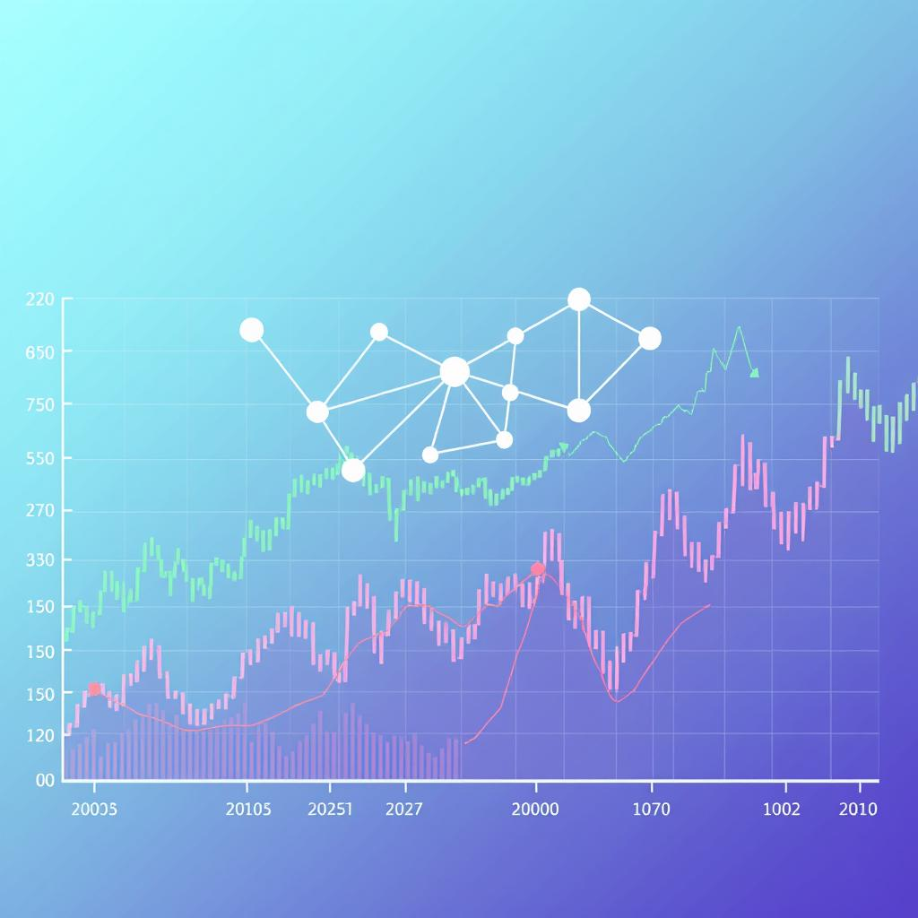
Why LSTM for Stock Prediction?
Long Short-Term Memory (LSTM) networks are ideal for stock price forecasting. Their design allows them to learn long-term dependencies in sequential data, which is crucial for identifying historical patterns in financial markets.
Training/Testing LSTM MODEL:
We have created a variable, look_back=60, which sets the number of previous time steps to use as input for learning the prediction of next time step. So, the model will learn to map last 60 days of input sequences to the output value of next day.
We have created a variable window_size=60. While testing, to predict the stock price of a specific day(on unseen dataset),the model analyses last 60 days price and based on that the predicts the stock price on unseen dataset and the window continues for the whole test dataset
LSTM's Key Advantages:
Sequential Dependency: LSTMs excel at capturing intricate temporal relationships in stock prices, learning from sequences of daily values.
Memory Retention: They overcome the vanishing gradient problem, retaining crucial information about past events that influence future performance.
Superior Performance: Our evaluation showed the LSTM model achieved lower MSE as well as lower MAE compared to CNN-based approaches, confirming its accuracy for financial forecasting.
In our case also LSTM performs better compared to CNN in terms of model accuracy and overall performance efficiency. Therefore, we are finalizing LSTM model in our project.

Slide 4



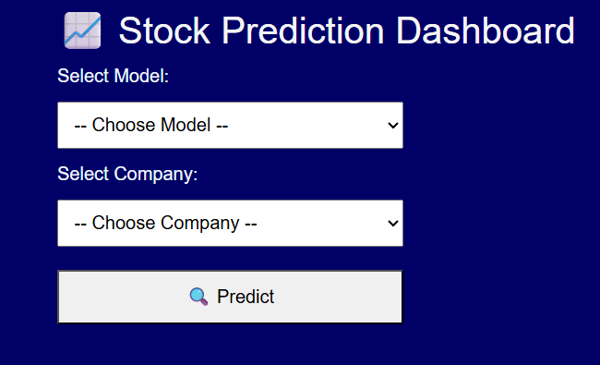
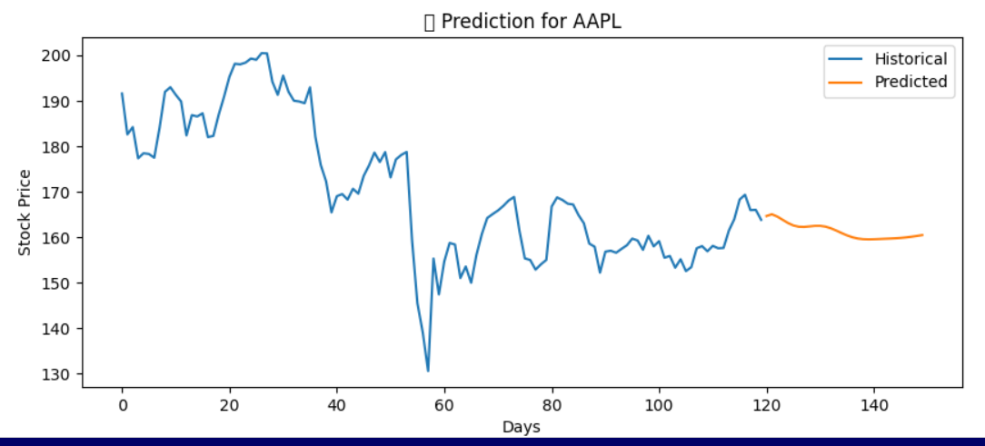
Front-end: User Interface & Interaction
Our intuitive front-end, built with HTML, CSS, and JavaScript, enables seamless user interaction for personalized stock predictions. Users can easily navigate through data selection and visualize complex financial forecasts in an accessible manner. We've focused on creating a clean, responsive interface that provides immediate insights.
Sector
Company
Predict
Choose from diverse sectors like IT, Semiconductor or Business to filter available companies.
Once a sector is chosen, users can effortlessly select specific companies from our pre-trained dataset within that chosen sector.
Generate a 30-day stock prediction graph with the respective tabular data displayed below for the selected company, offering detailed figures for comprehensive analysis and decision-making.

Slide 5




Back-end: Flask API Framework
Our project leverages the Flask Python framework to deploy the stock prediction model as a robust and scalable API. This backend handles all core logic and data interactions.
App.py
Contains the main backend logic, handling API endpoints and orchestrating interactions.
Predictor.py
Houses the core prediction logic, utilizing our trained LSTM model for forecasts.
Models Folder
Stores all individual trained datasets files for diverse companies across diverse sectors.
Template Folder
Contains the Index.html file, serving as the frontend interface for user interaction.

Slide 6
Future Work: Uncovering and Analyzing Universal Market Patterns
1
Focused Dataset Training
2
Pattern Recognition
We are advancing our project by training and testing the LSTM model on a limited, curated set of diverse company datasets.
The core objective is to identify underlying, common patterns and shared characteristics across these varied datasets.
3
Enhanced Predictive Capability
4
Future Implications
By leveraging these deeper conceptual insights, our goal is to develop a model capable of generating nearly accurate stock price predictions for any new, unseen company provided by the user, extending beyond our initial training set.
This generalization concept aims to build a more robust and adaptable stock prediction system, less reliant on company-specific training and more on universal market dynamics.

Slide 7

Project Conclusion & Universal Market Insights
Our deep learning model, powered by LSTM networks, has demonstrated robust performance in forecasting stock prices. The project successfully navigated complex data to deliver nearly accurate predictions, establishing a strong foundation for advanced financial analytics.
Cross-Market Analysis
1
We utilize international statistical methods such as multivariate time-series analysis to uncover universal market patterns beyond specific company data.
Unseen Company Adaptability
2
Our model's generalization capabilities allow it to predict nearly accurate prices for any new, unseen company by adapting to its unique market dynamics.
Future work
3
We create correlation columns using advanced normalization techniques to identify and leverage inter-company relationships across diverse sectors.

